Slide 1


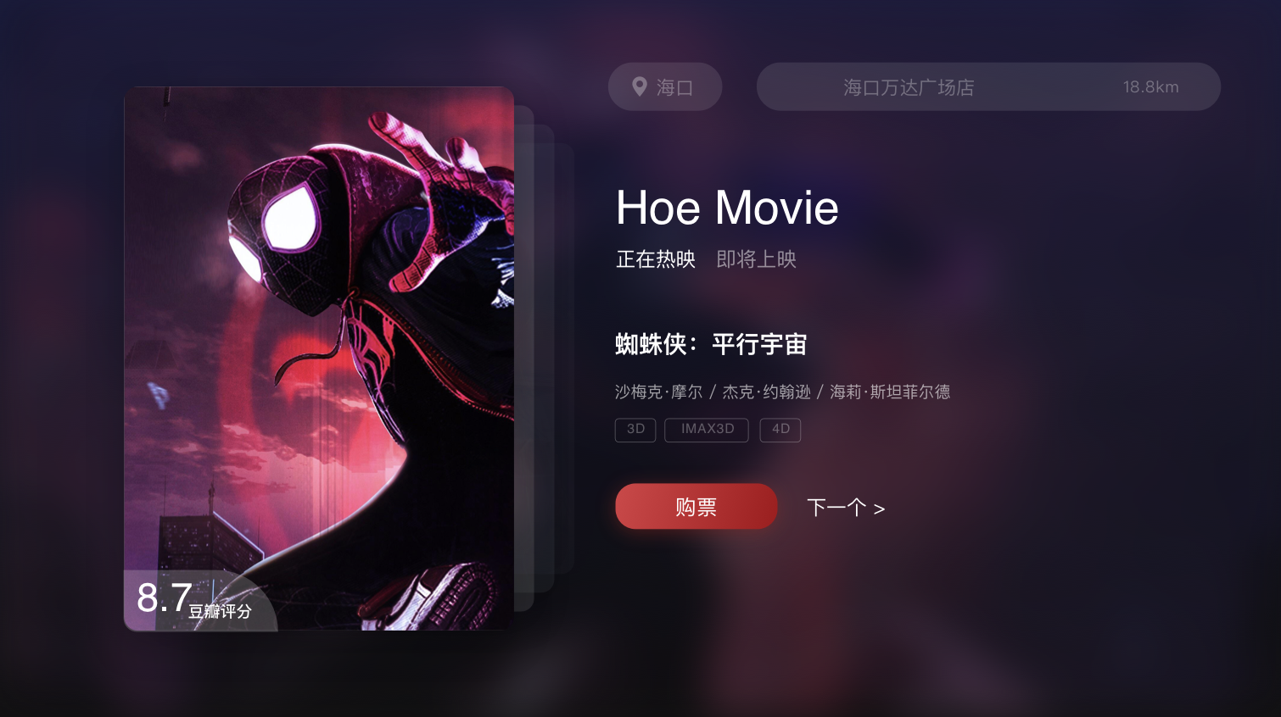

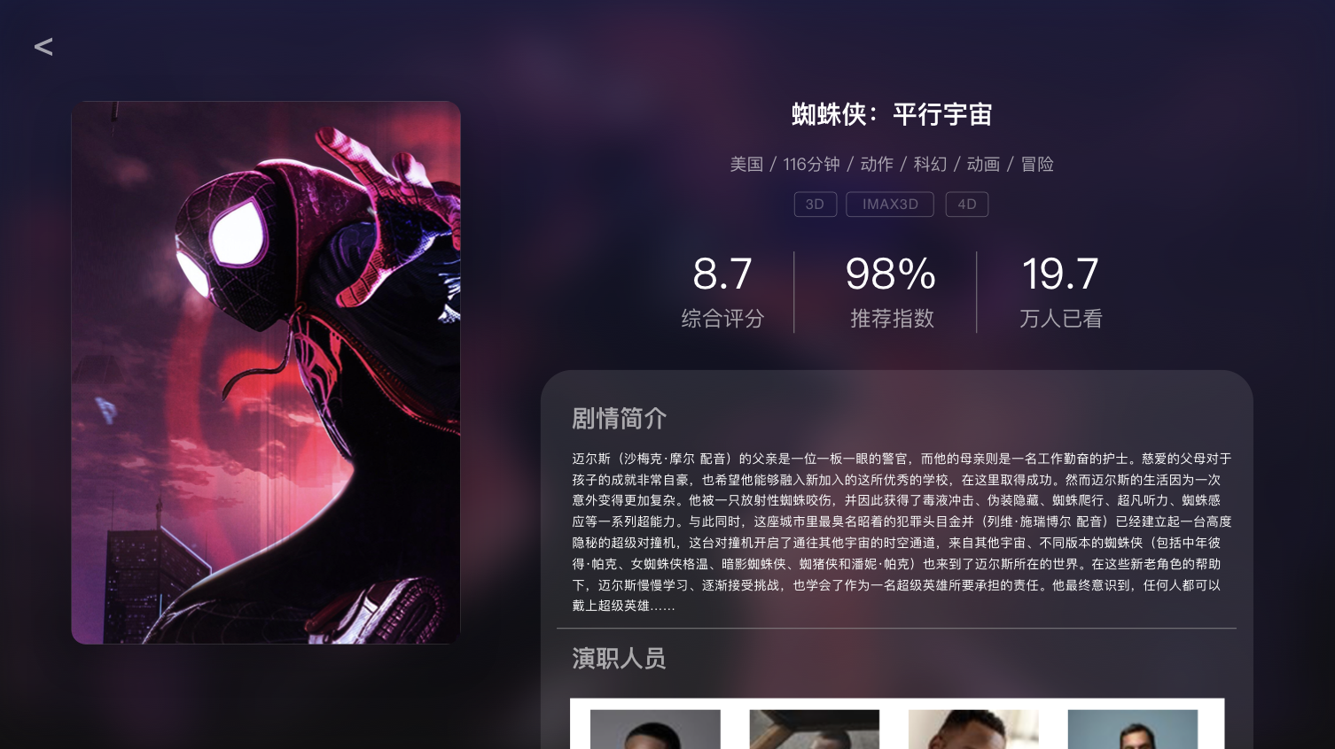


Slide 2

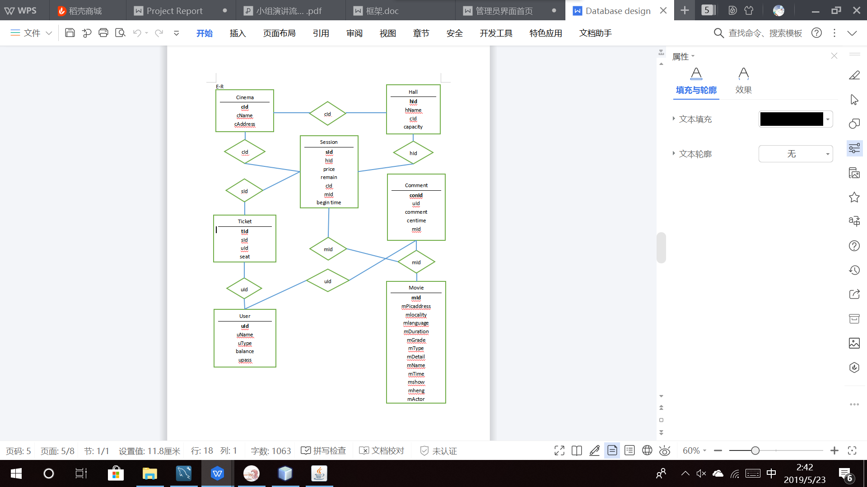
According to the demand analysis conducted in the early stage of our project, we drew the e-r graph for the data

Slide 3
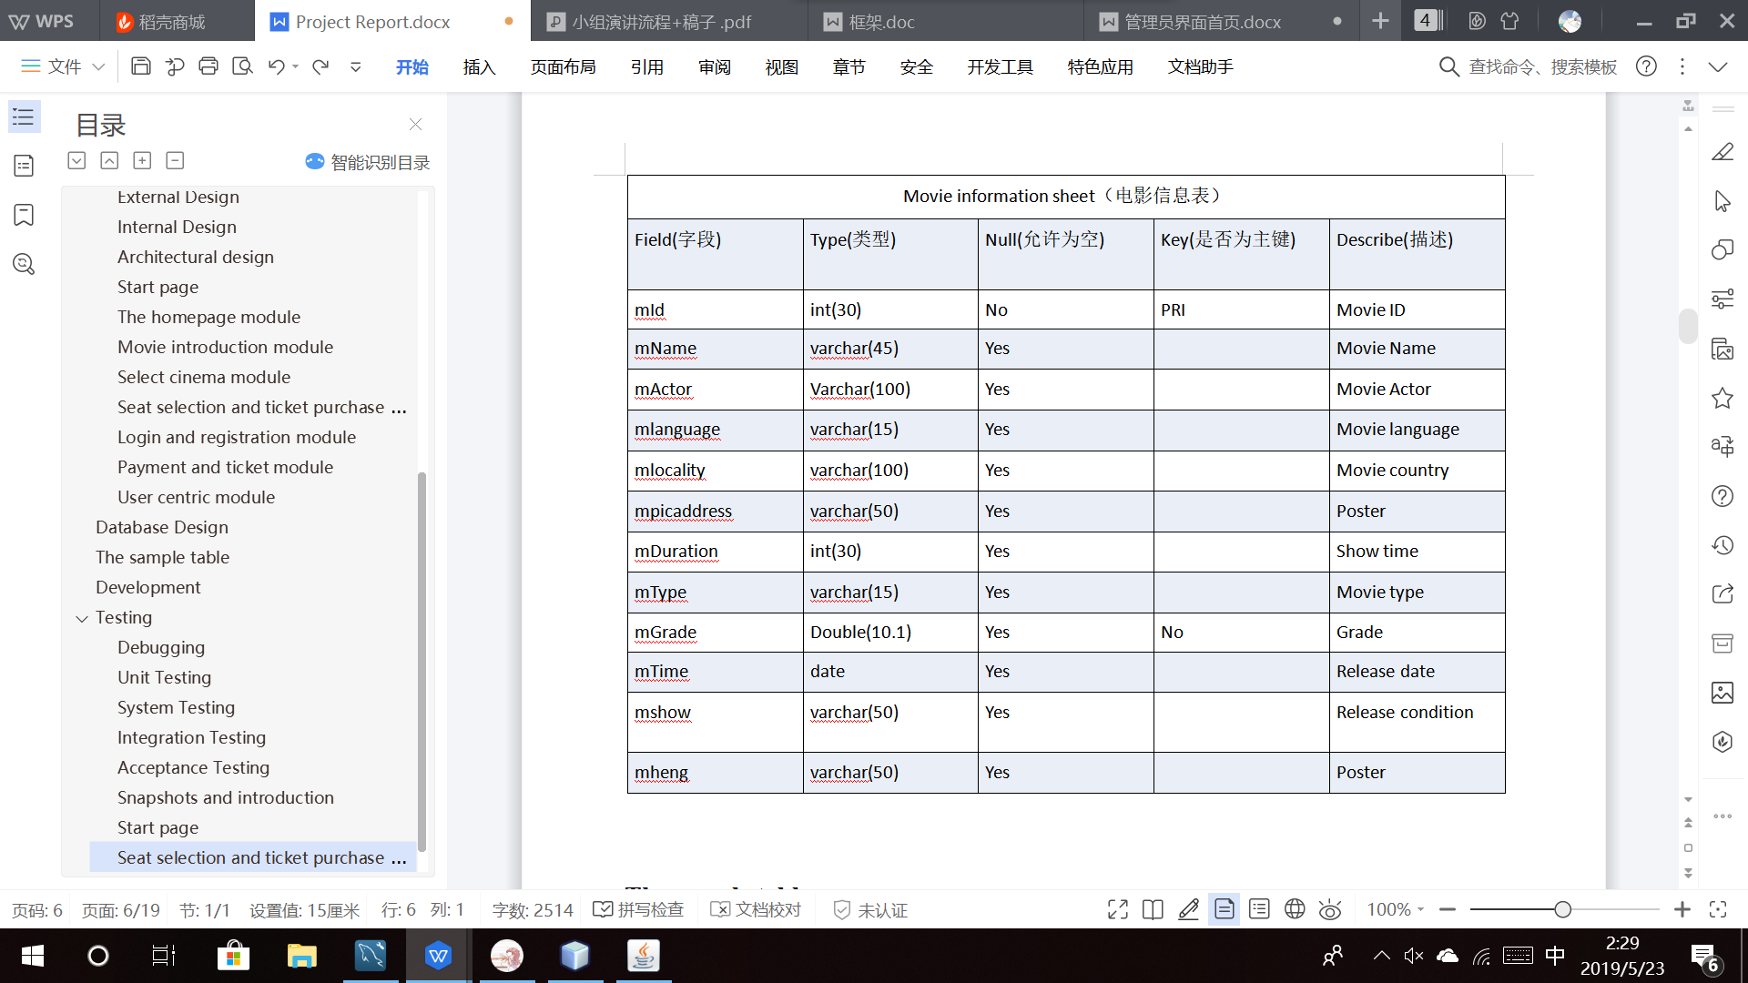
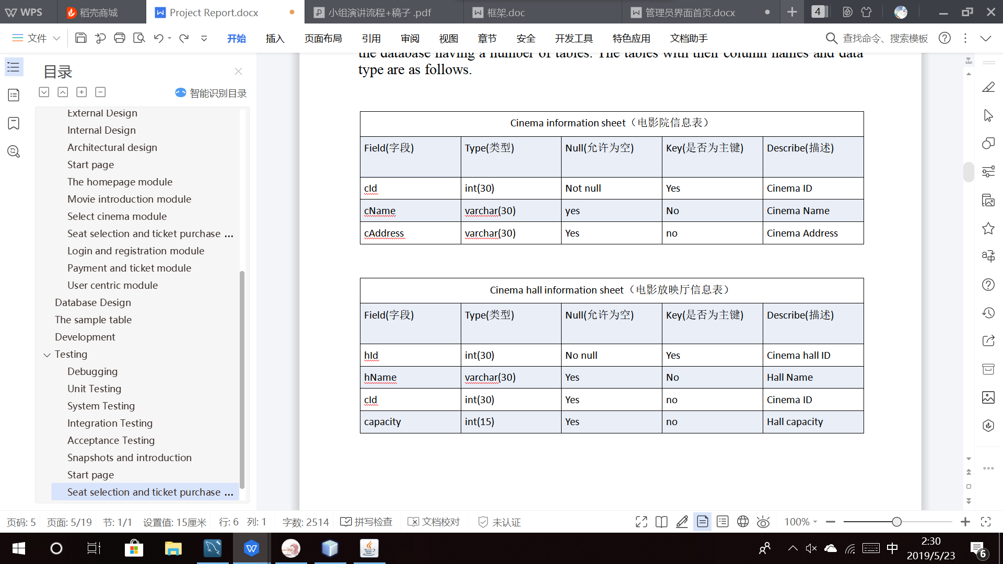
Part of a data item

Slide 4
3-tier architecture
Interface layer
Business logic layer
Data access layer

Slide 5
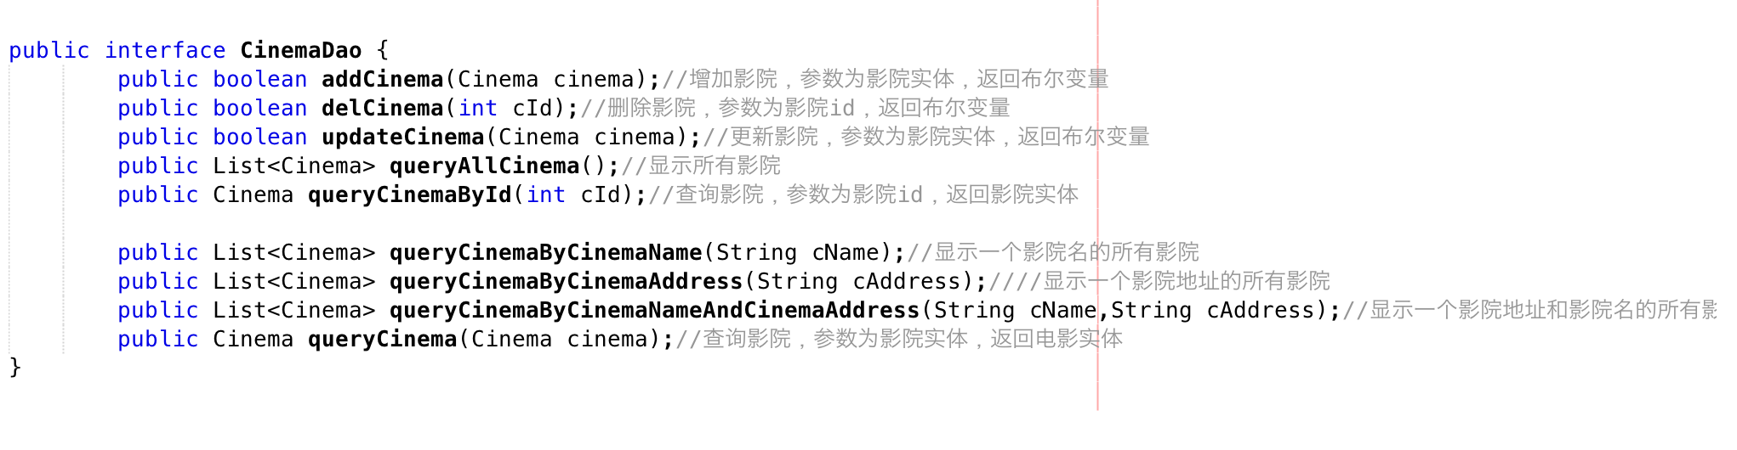
Data access layer

Slide 6
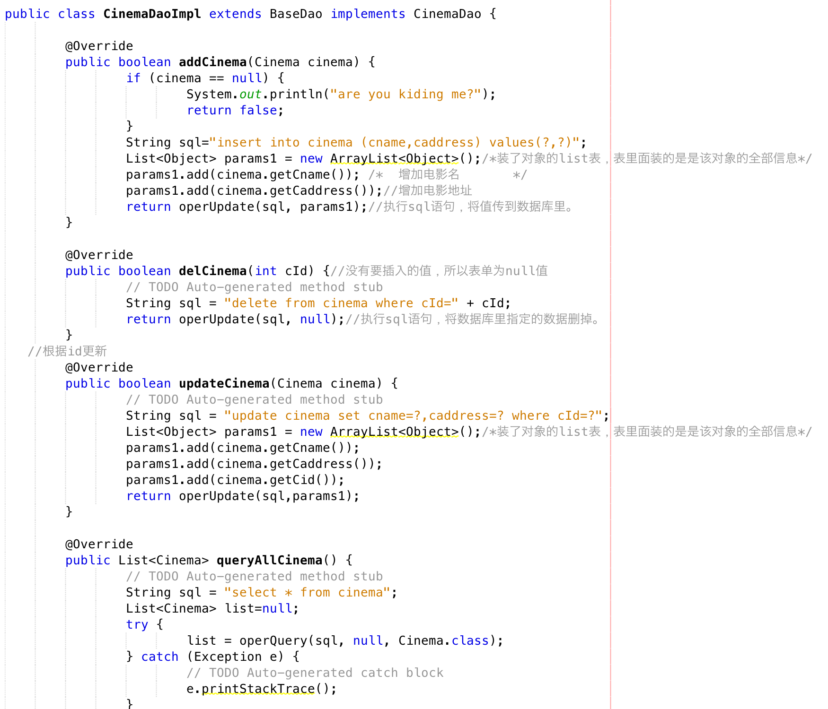
Data access layer

Slide 7
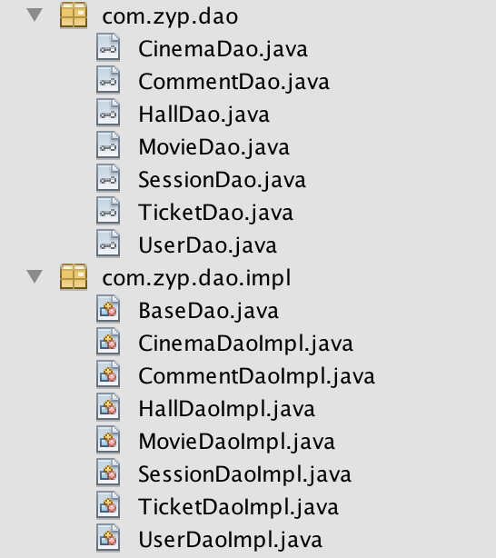
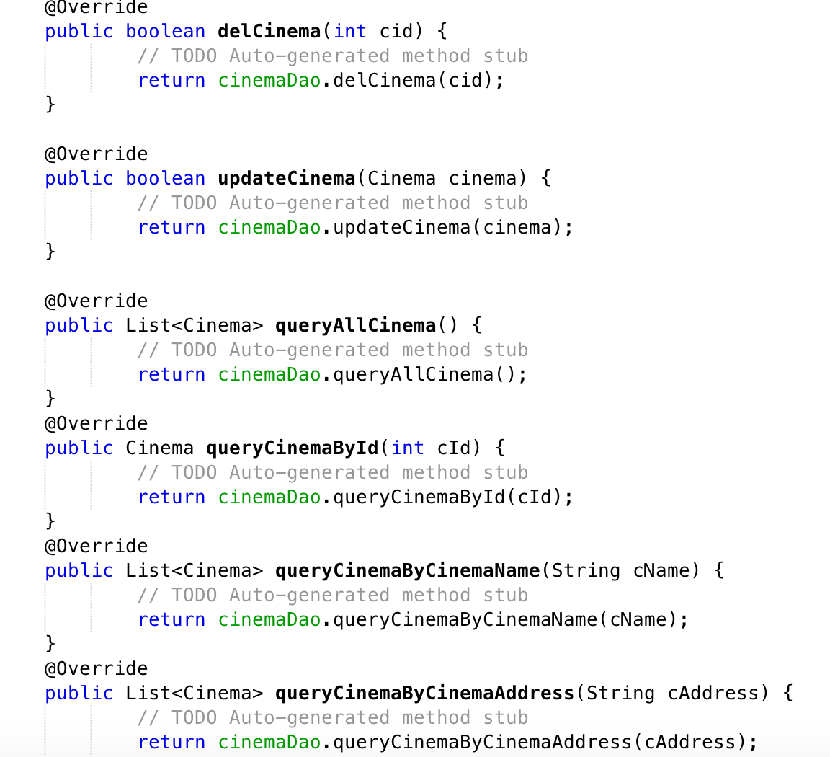
Data access layer

Slide 8
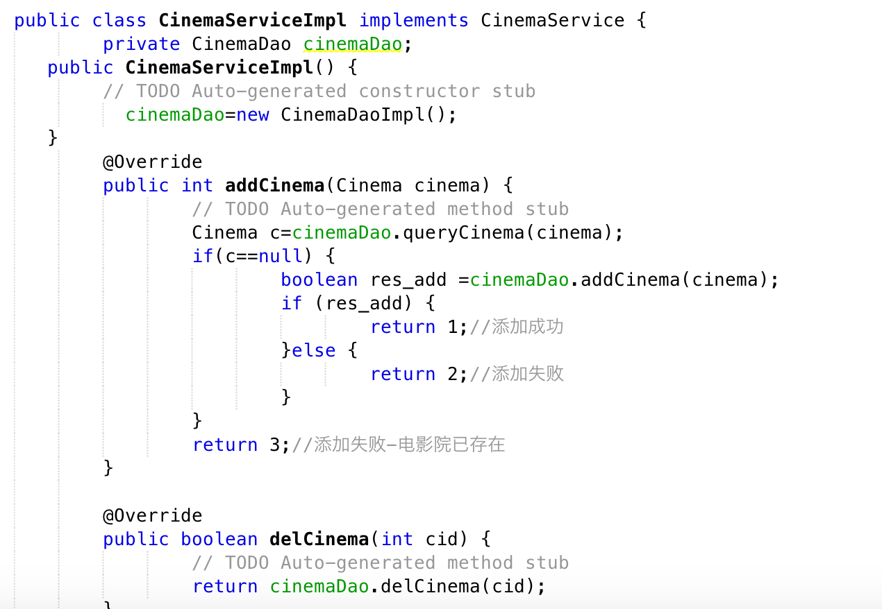
Business logic layer

Slide 9
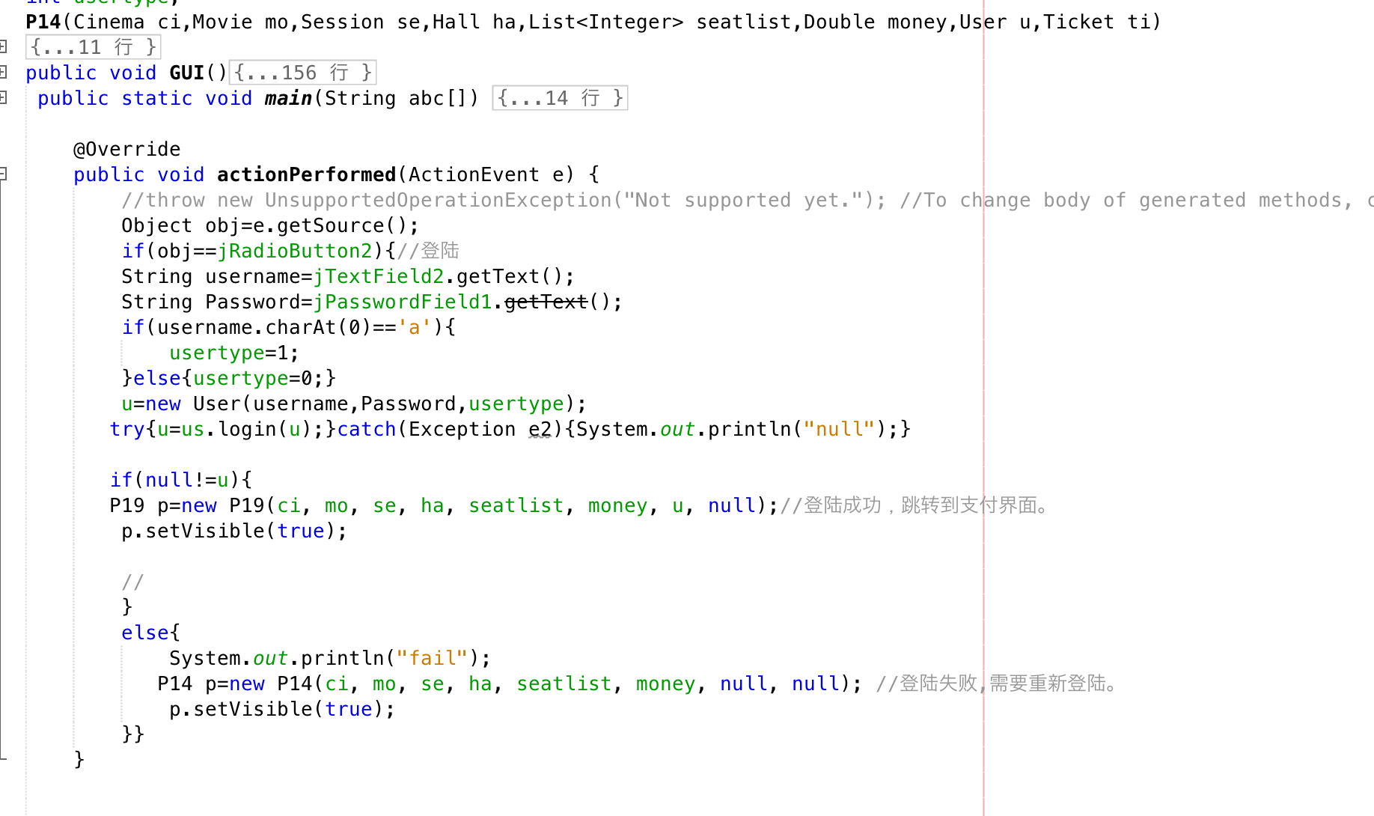
Interface layer

Slide 10
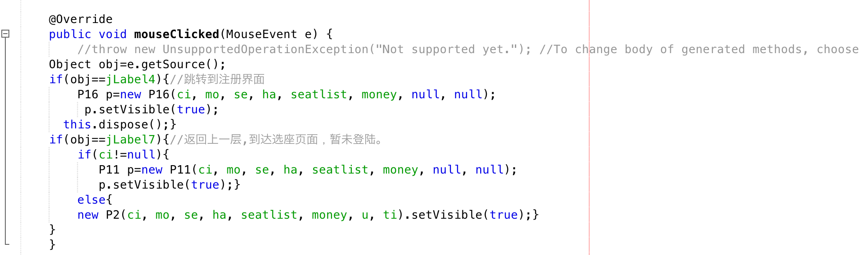
Interface layer

Slide 11
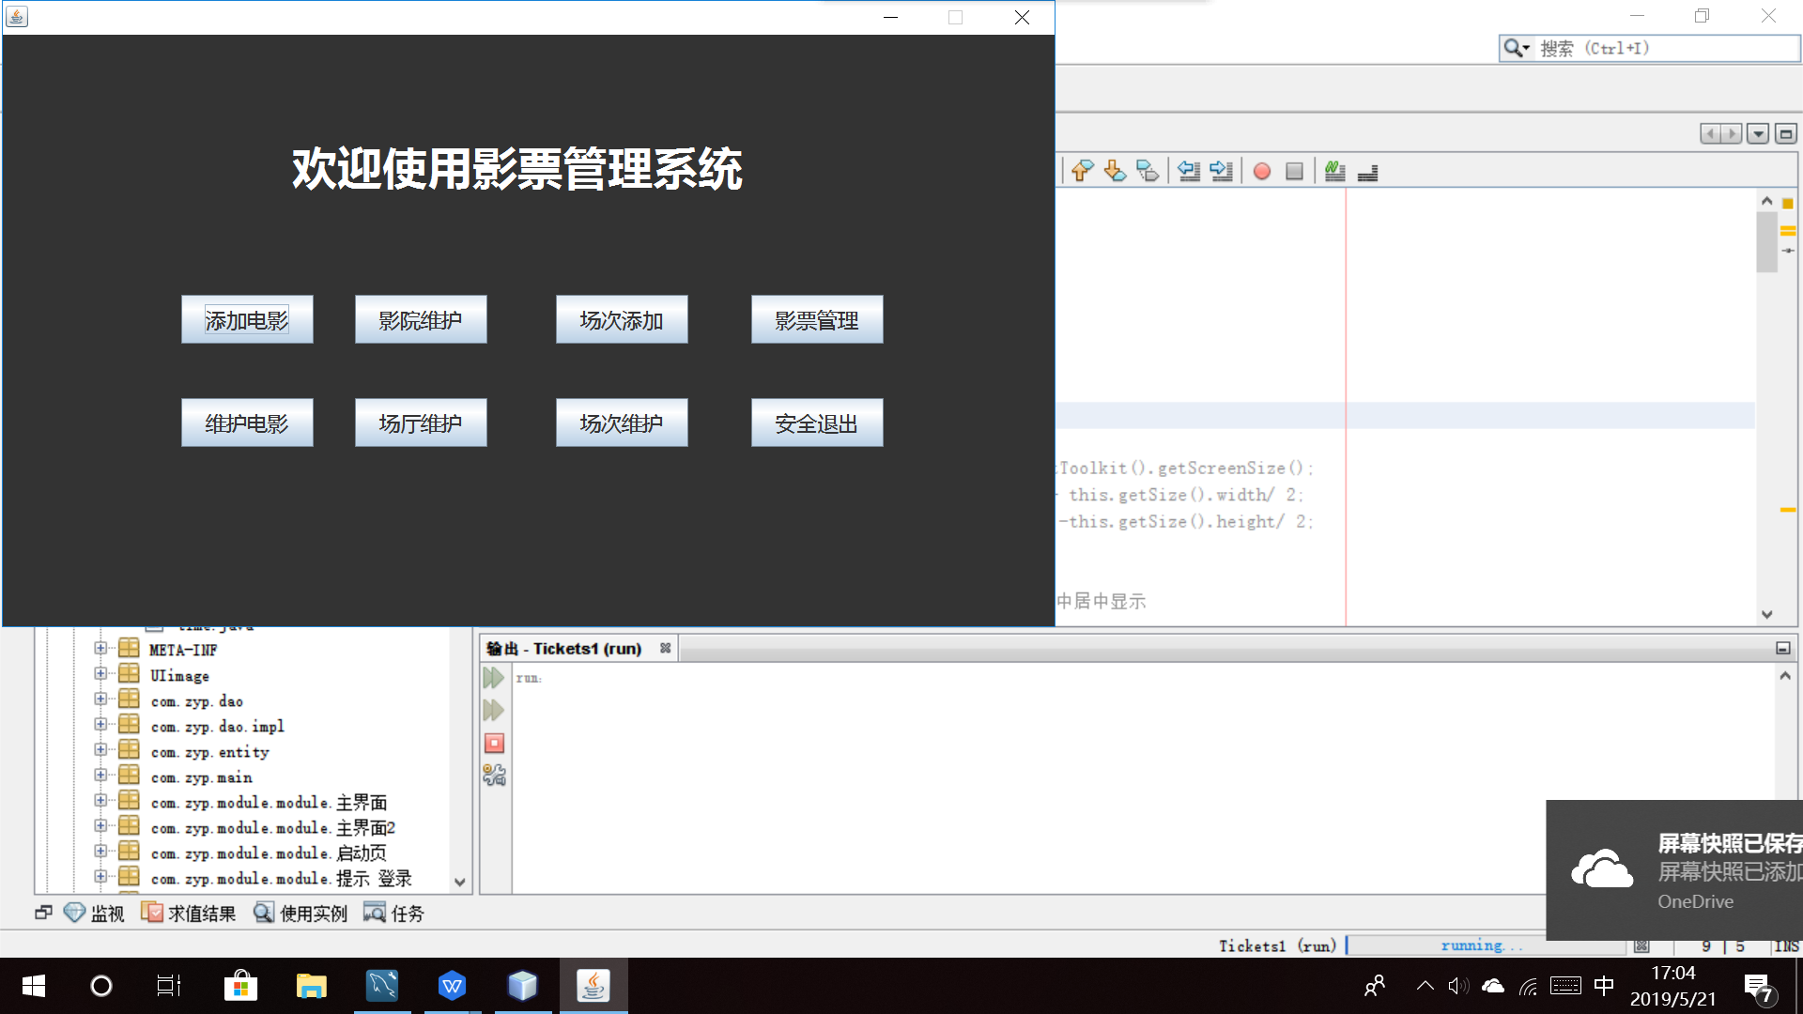
The home page

Slide 12
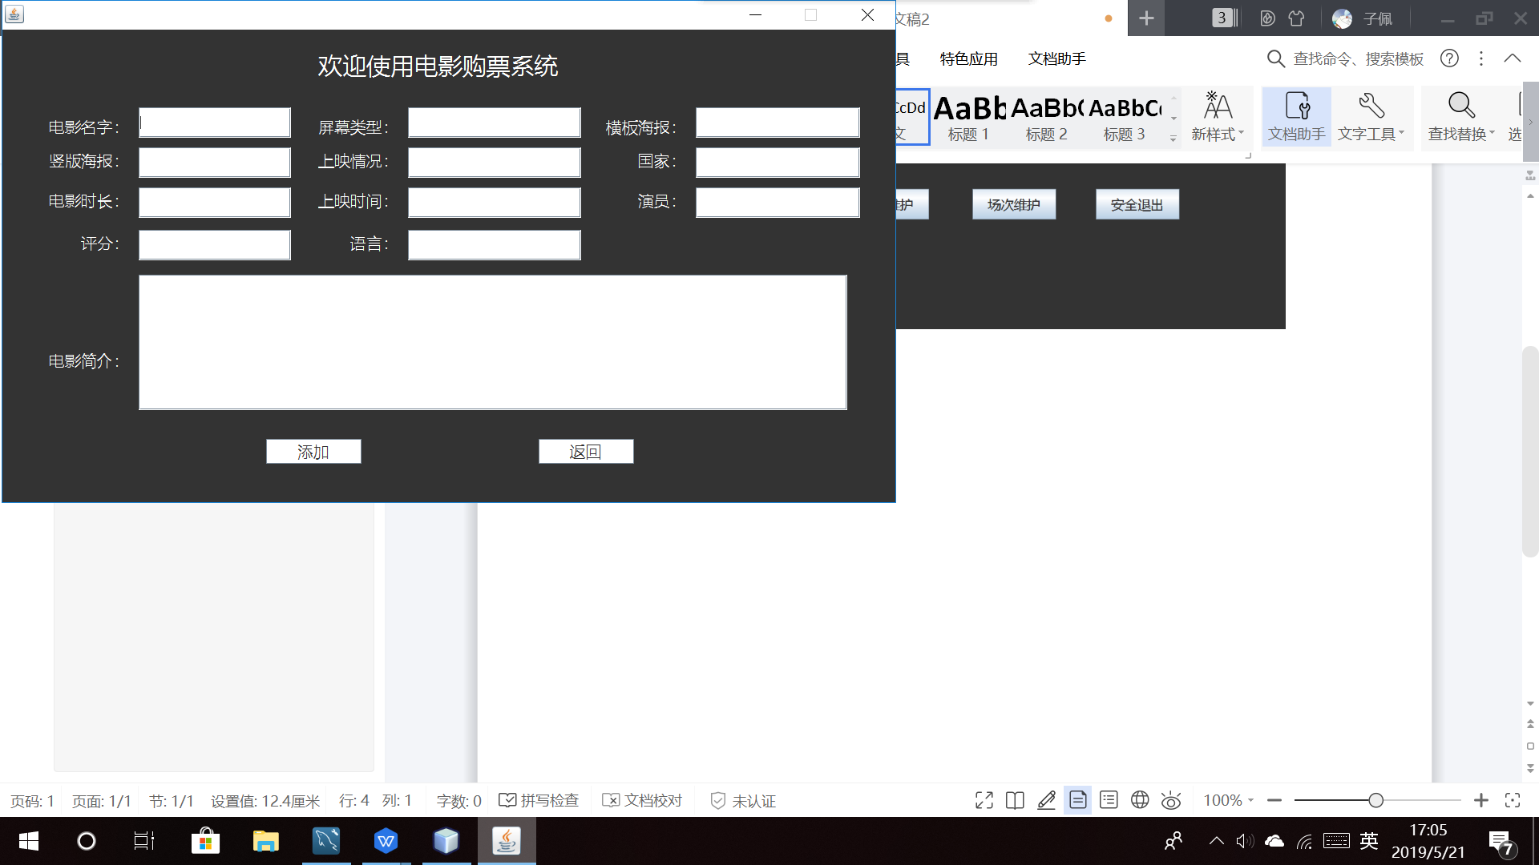
Add movie interface

Slide 13
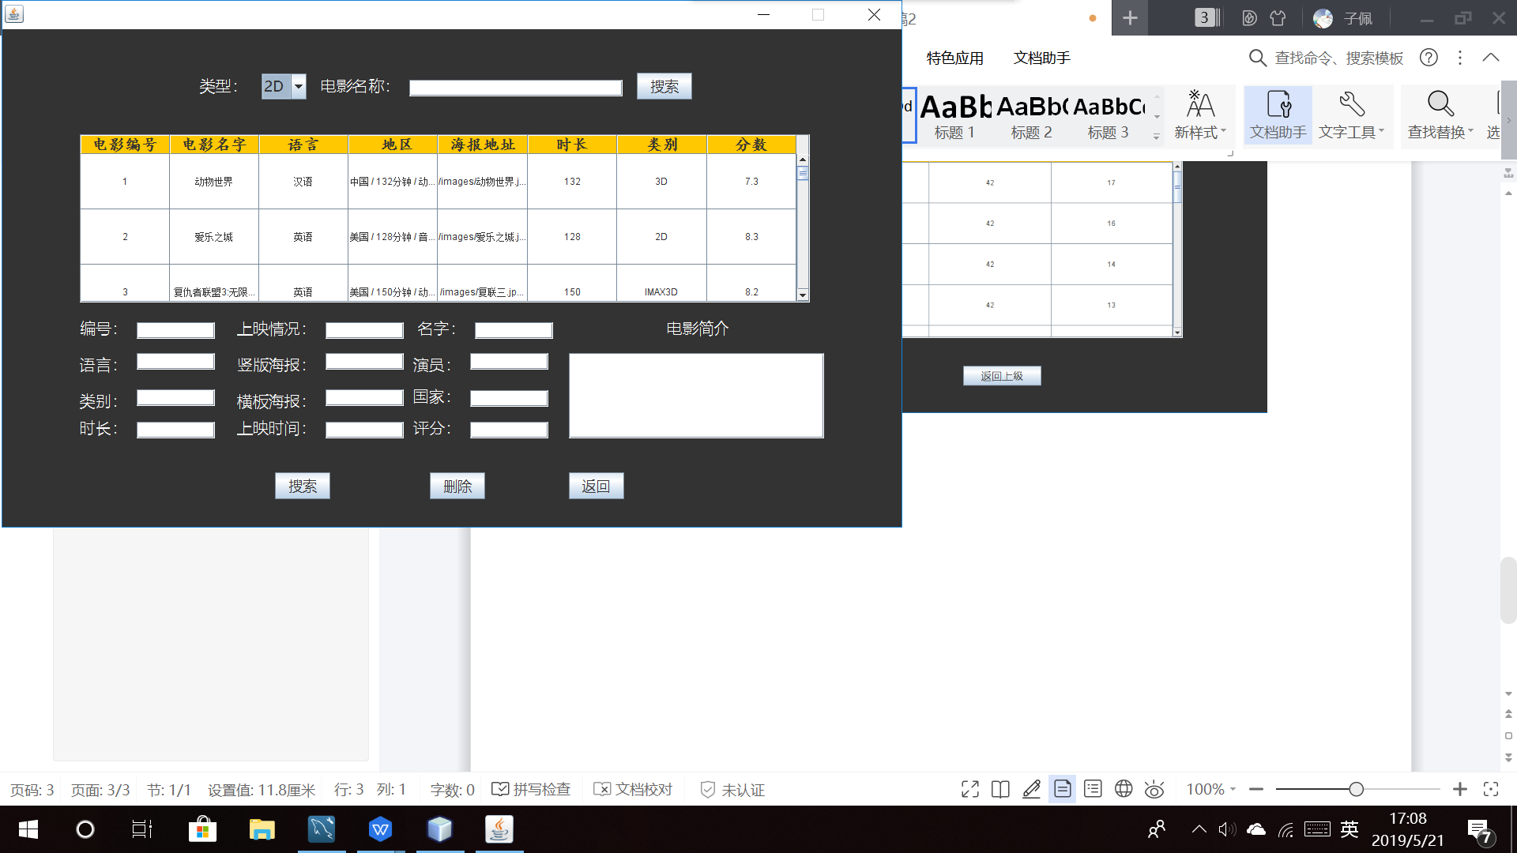
Maintain the movie interface

Slide 14
UI Design

Slide 15
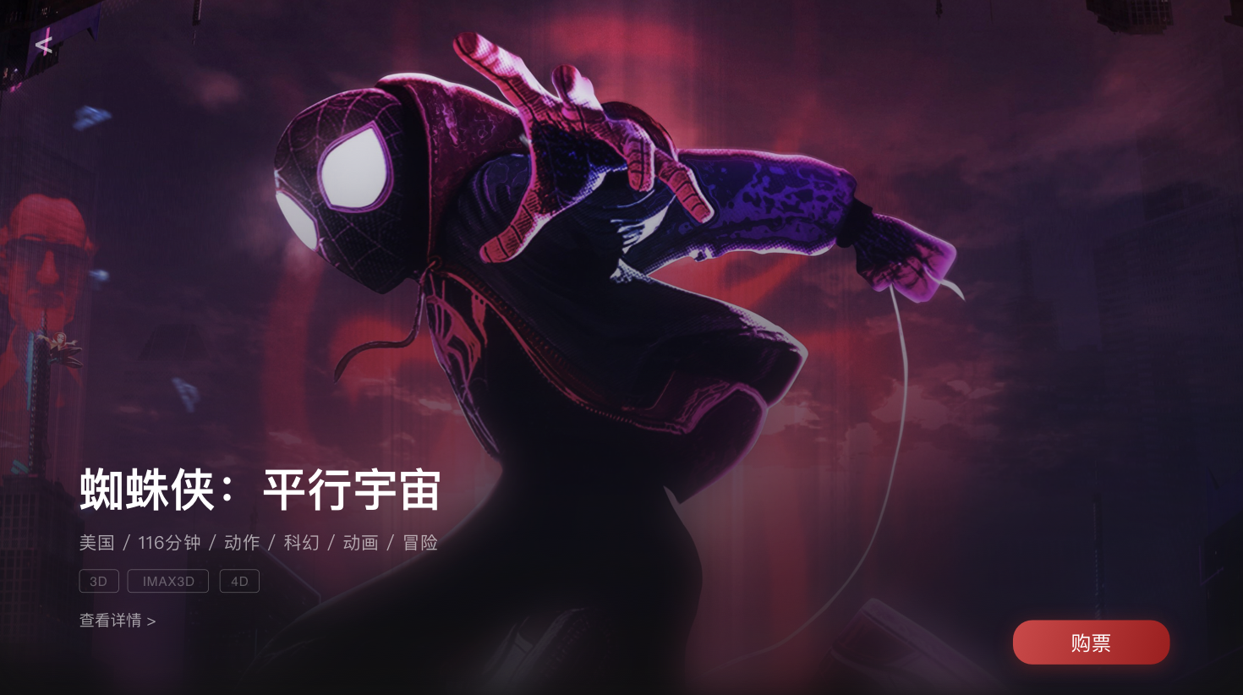

Design Specification
We designed all the software interfaces
Dark - based, with classic blues and reds
On the basis of practicality, the whole presents a sense of immersion and technology
Optimize product experience and enhance member service.
color
c84949
9a1f1f
191c61
Colour inspiration comes from 《Spider-Man Parallel Universe》. There are many classic red and blue matches.
Widely used in the field, the dark style is more immersive.
Opacity: 10%-90%
101010
Opacity: 10%-90%
ffffff

Slide 16
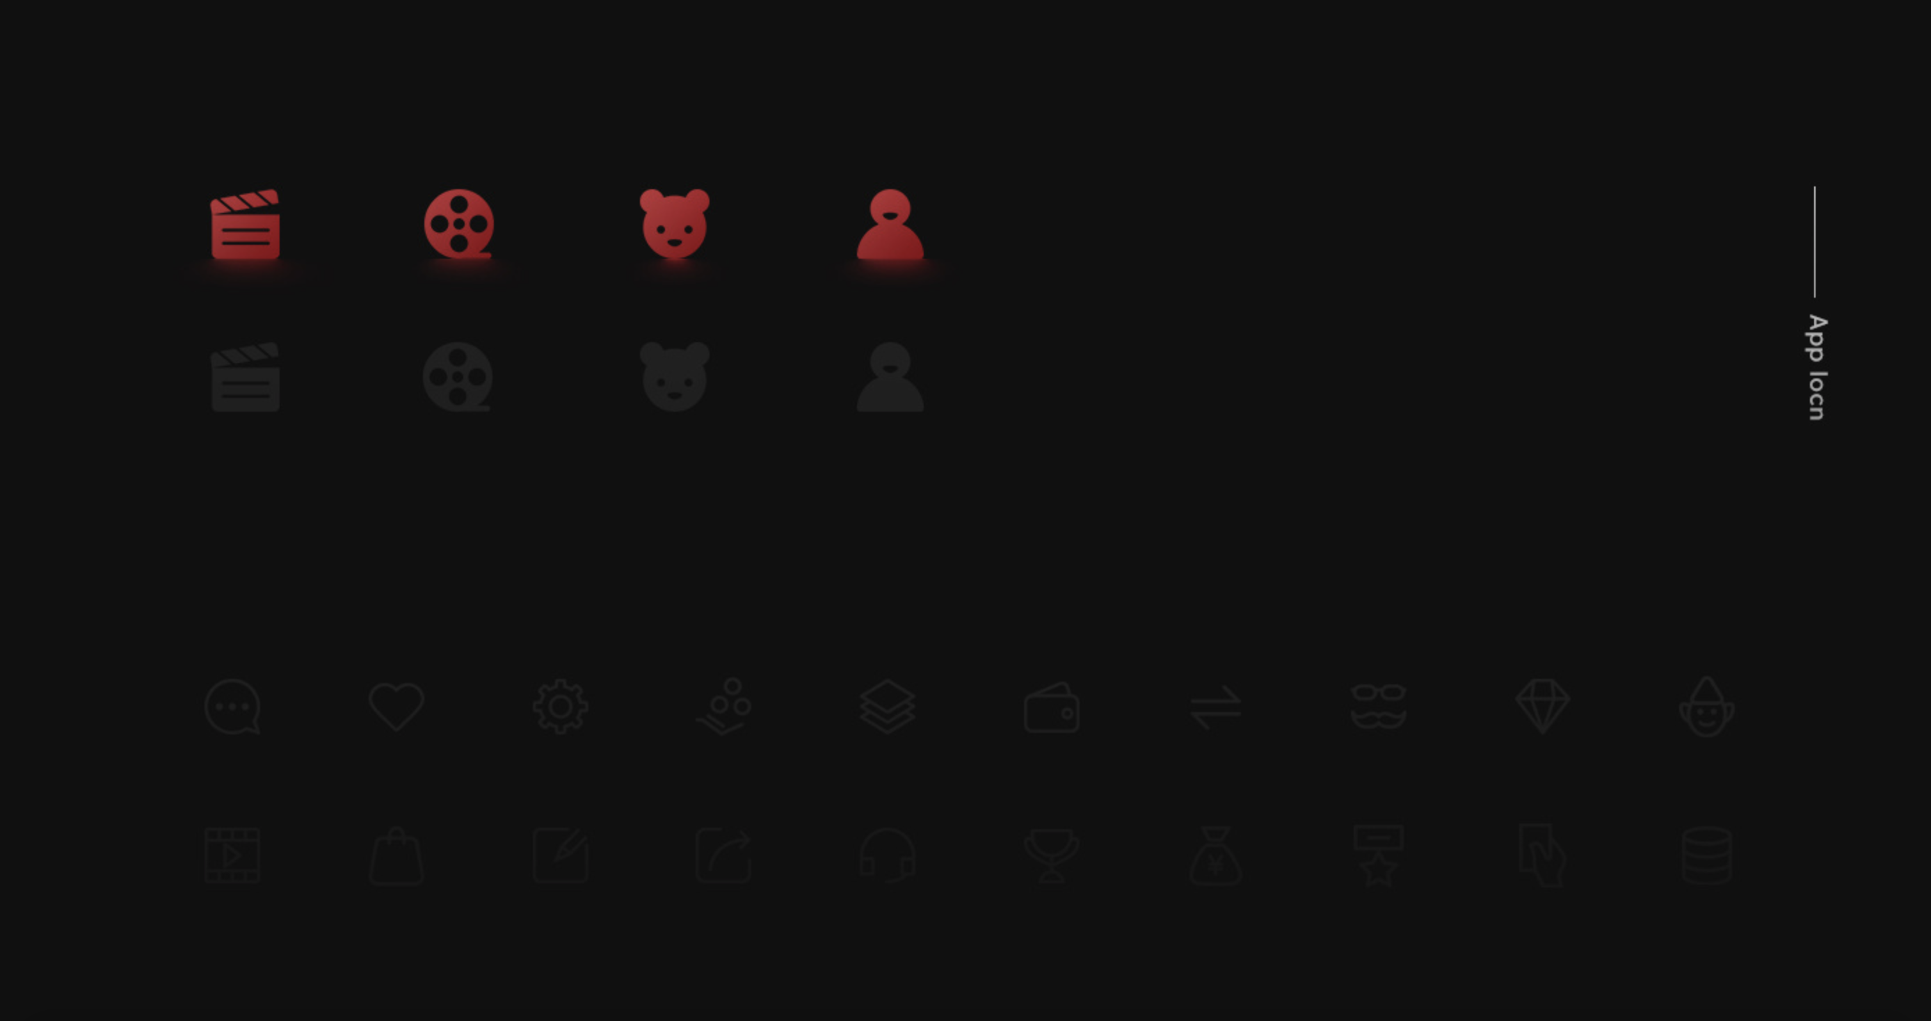
Red luminous Icon enhances the degree of cool, with black
It can better enhance the user's sense of immersion in using the software

Slide 17
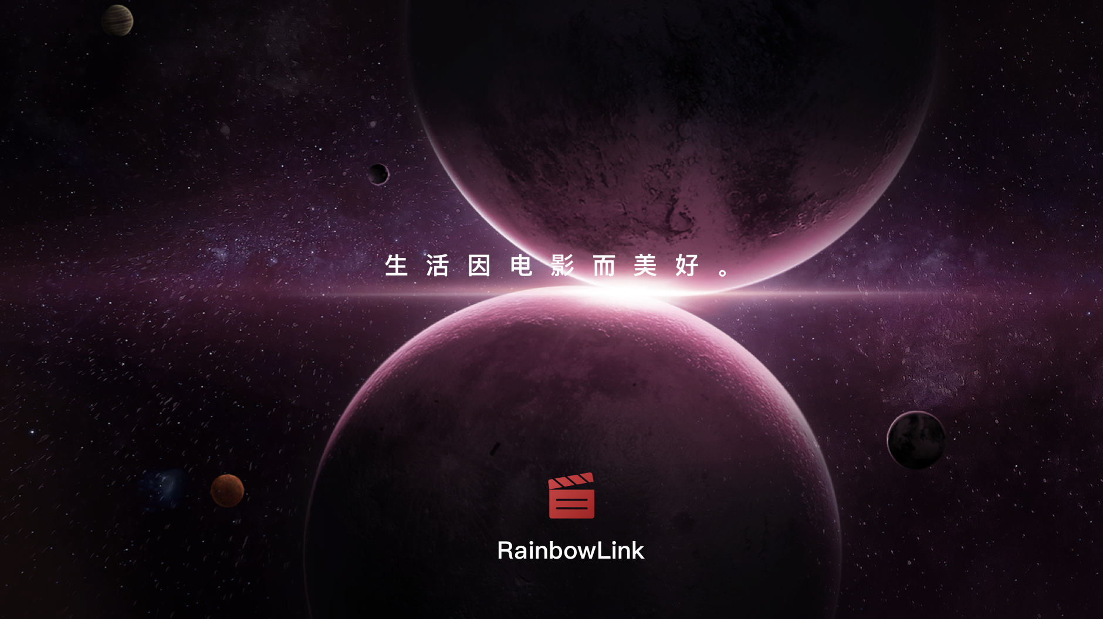
The startup page is the transition page of the product, which can improve the brand image and recognition
We display the startup page as a still image with text.

Slide 18
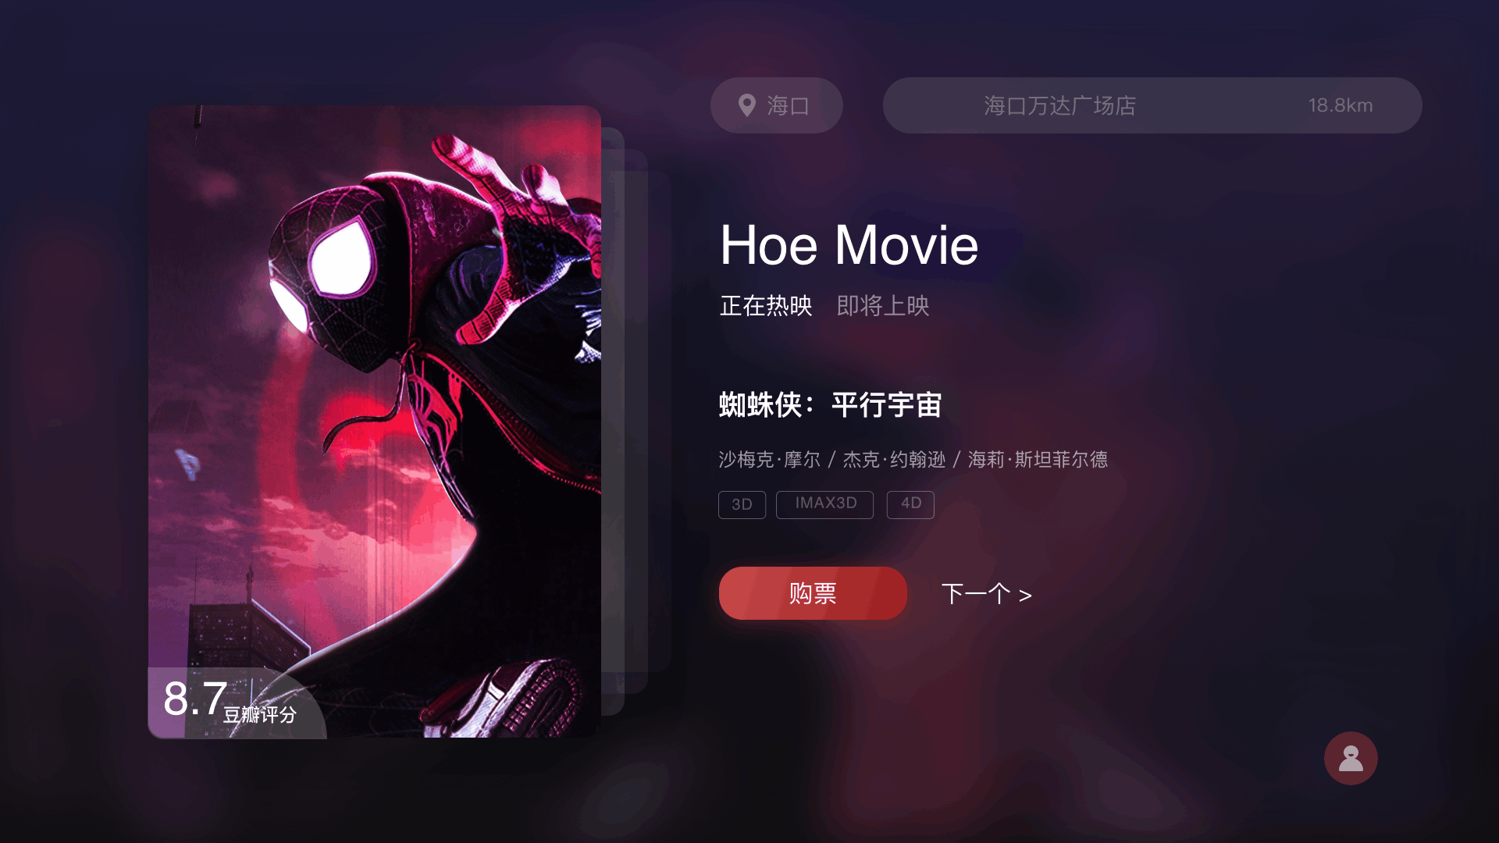
01
—— App RainbowLink
The Homepage
The home page takes the new movie as the core
demonstration, for the convenience demonstration.
We only played two pages.

Slide 19
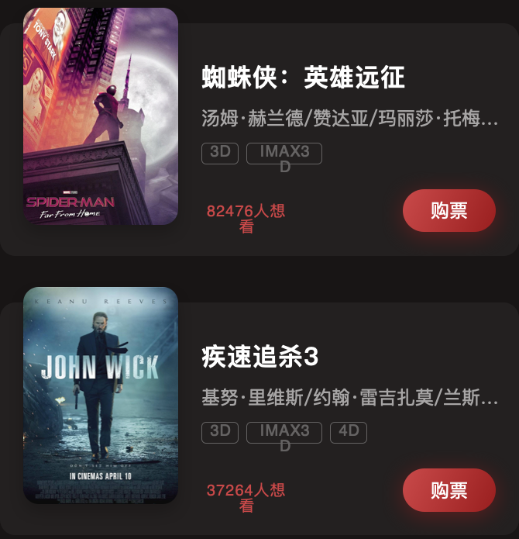
Movie Introduction
02
To show the details of the film,
Provide users with as much detailed
information as possible.

Slide 20
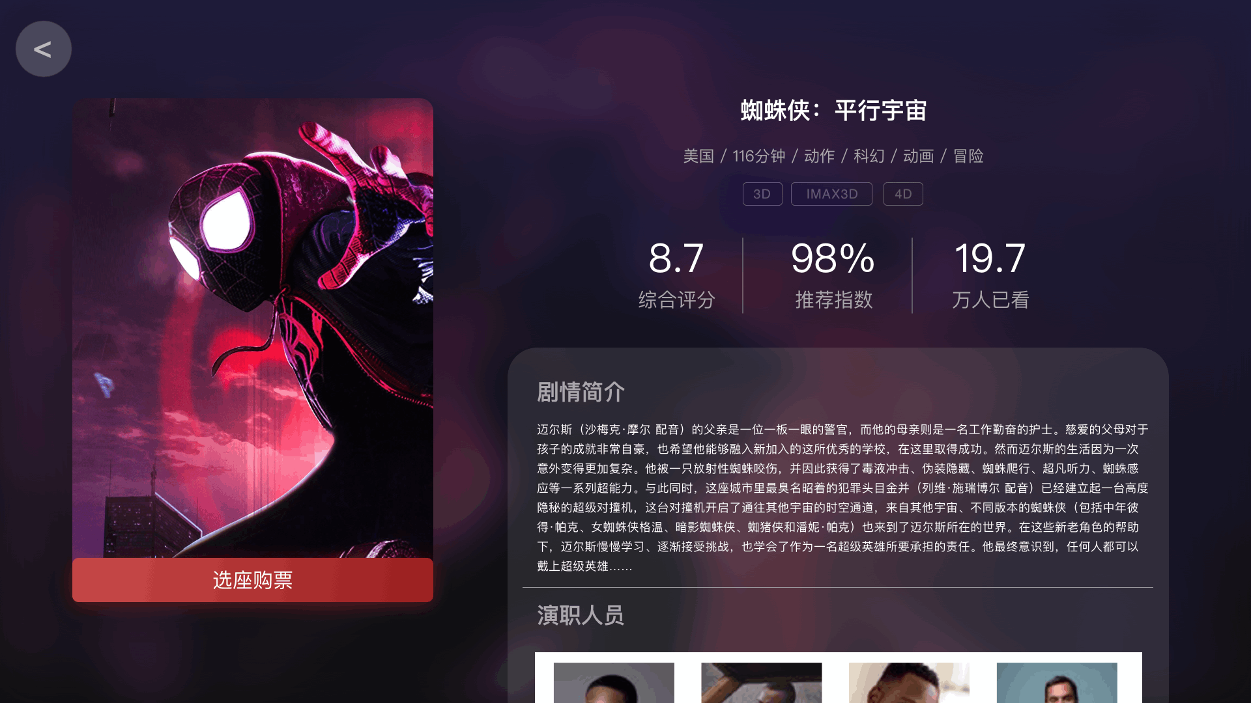
03
Select Theaters
There is an interface for selecting theaters
Comfortable spacing makes the selection easier
The red and white color scheme allows you to focus more on your choices
—— App Select Theaters

Slide 21
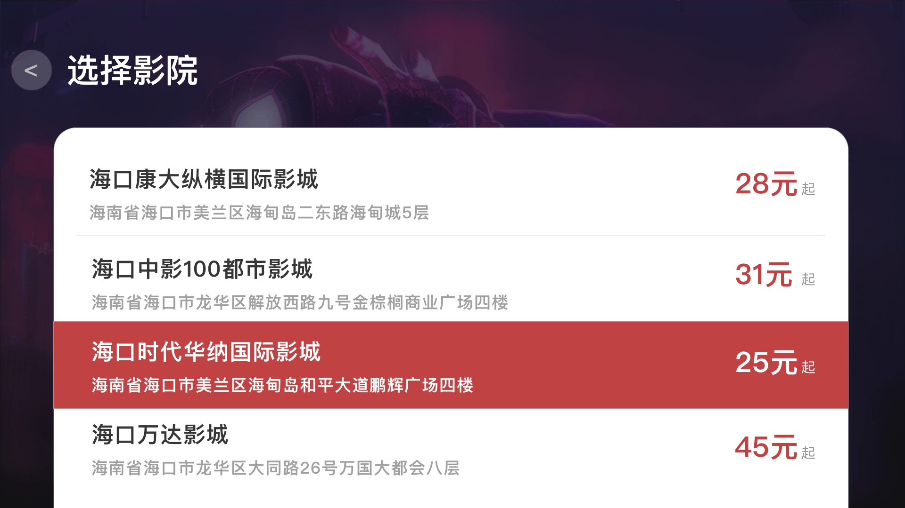
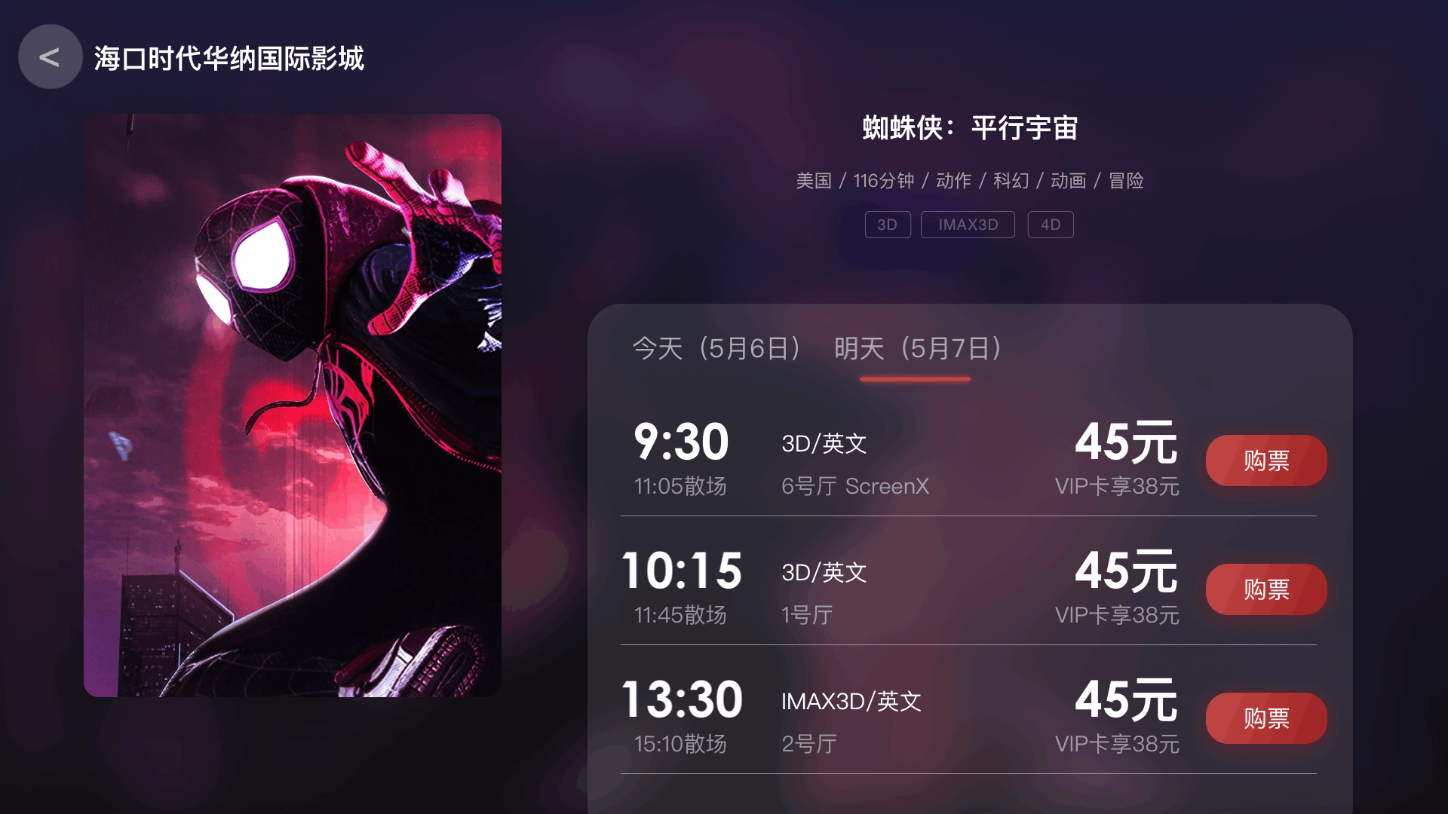
Seat and Ticket
04
—— App City Choice
The film blends in with the background and is
visually more immersive.
Buy tickets, select seats, and log in at one go.
Dialog box prompt, so that users who are not
logged in can also directly registered.

Slide 22
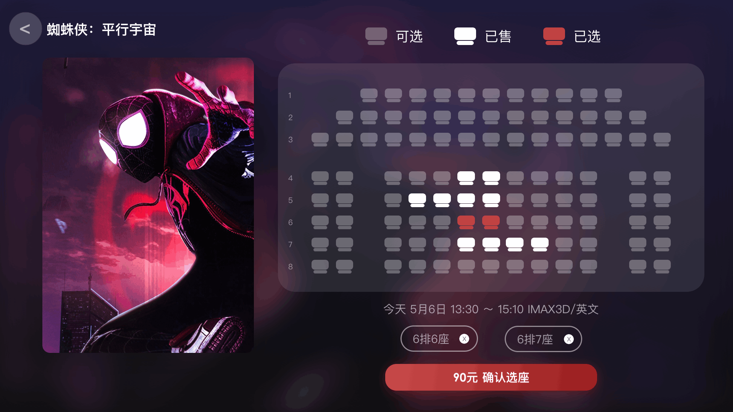
Login and Register
05
—— App Login and Register

Slide 23
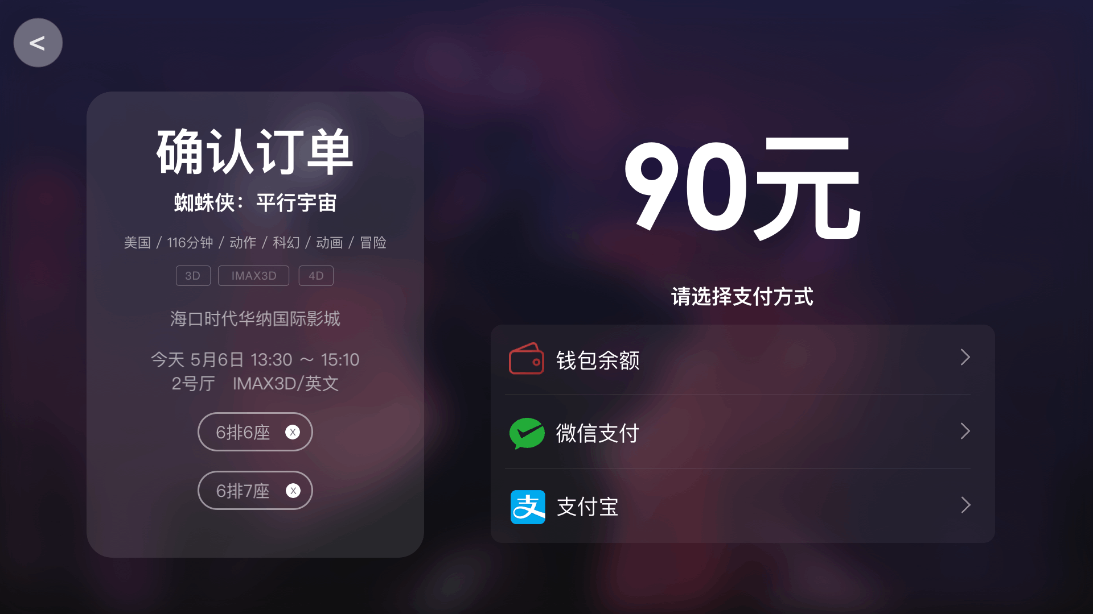
—— App Pay
06
Pay! Movie Tickets
When you complete the payment, we will send the tickets
For convenience, we can provide wallet balance,
WeChat and other payment methods
Generate ticket ticket qr code to facilitate
direct scanning to get tickets

Slide 24
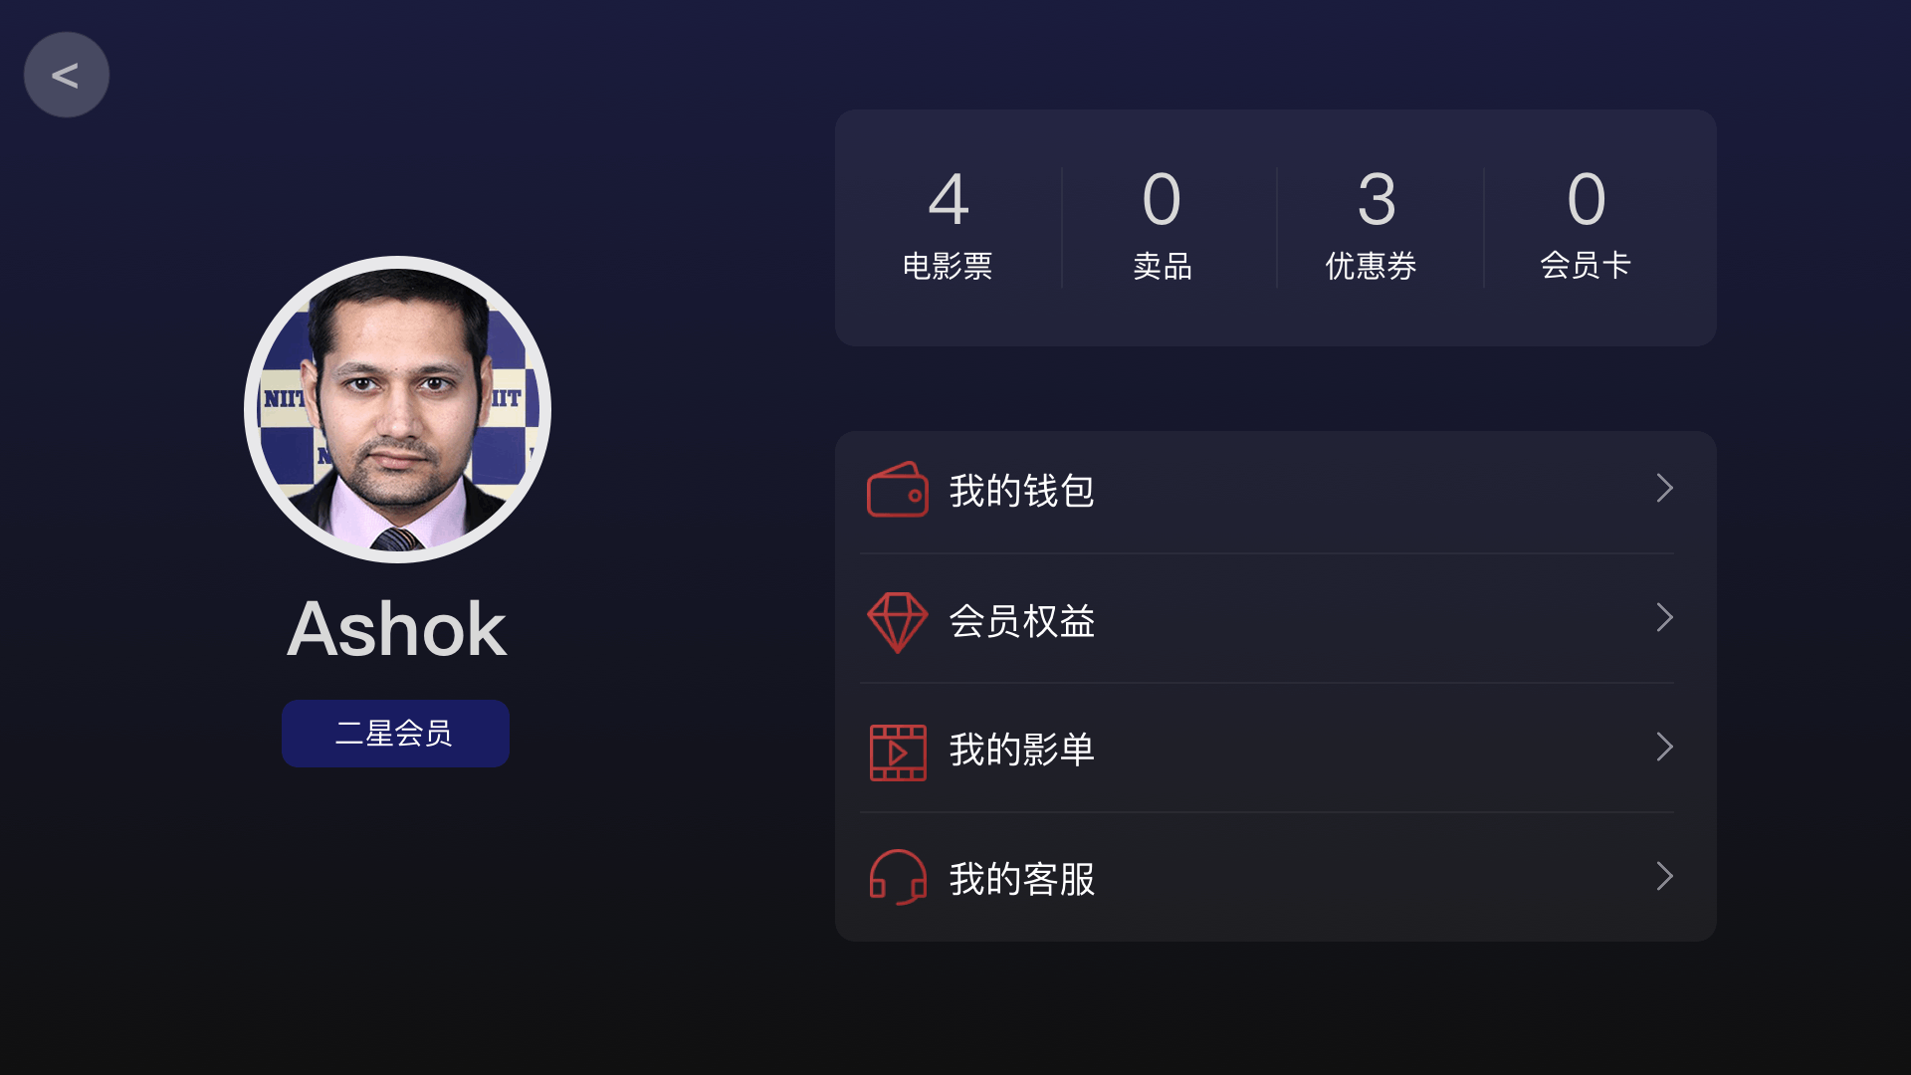
—— App City Choice
07
The User Center
The user center function and the style have
carried on the reorganization, the design
We provide VIP card service, top-up service
and customer service

Slide 25
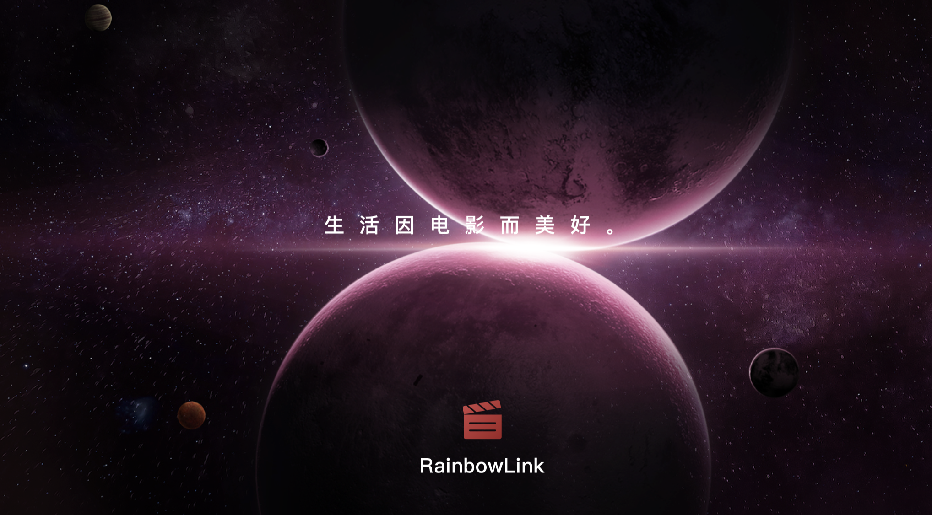
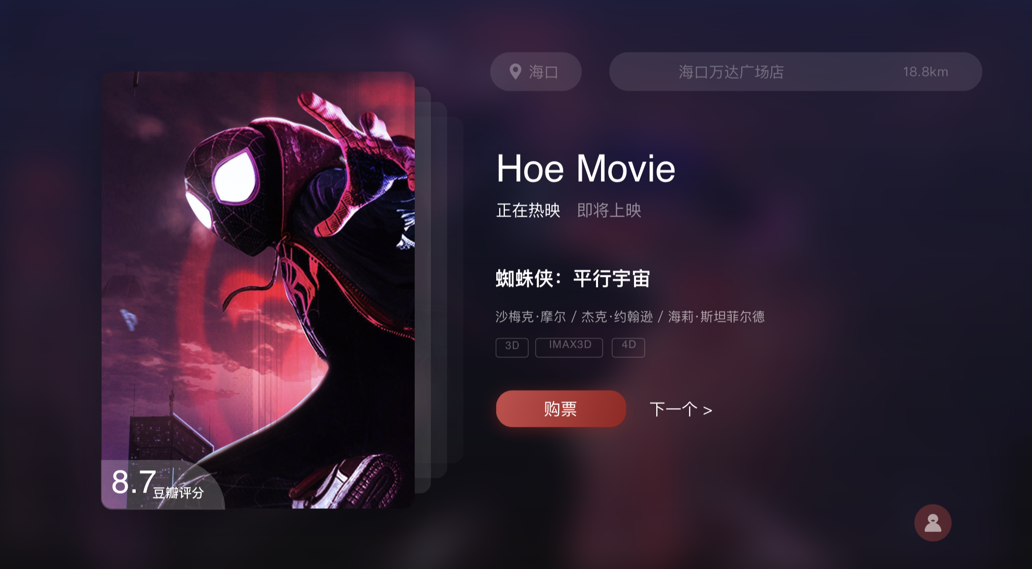
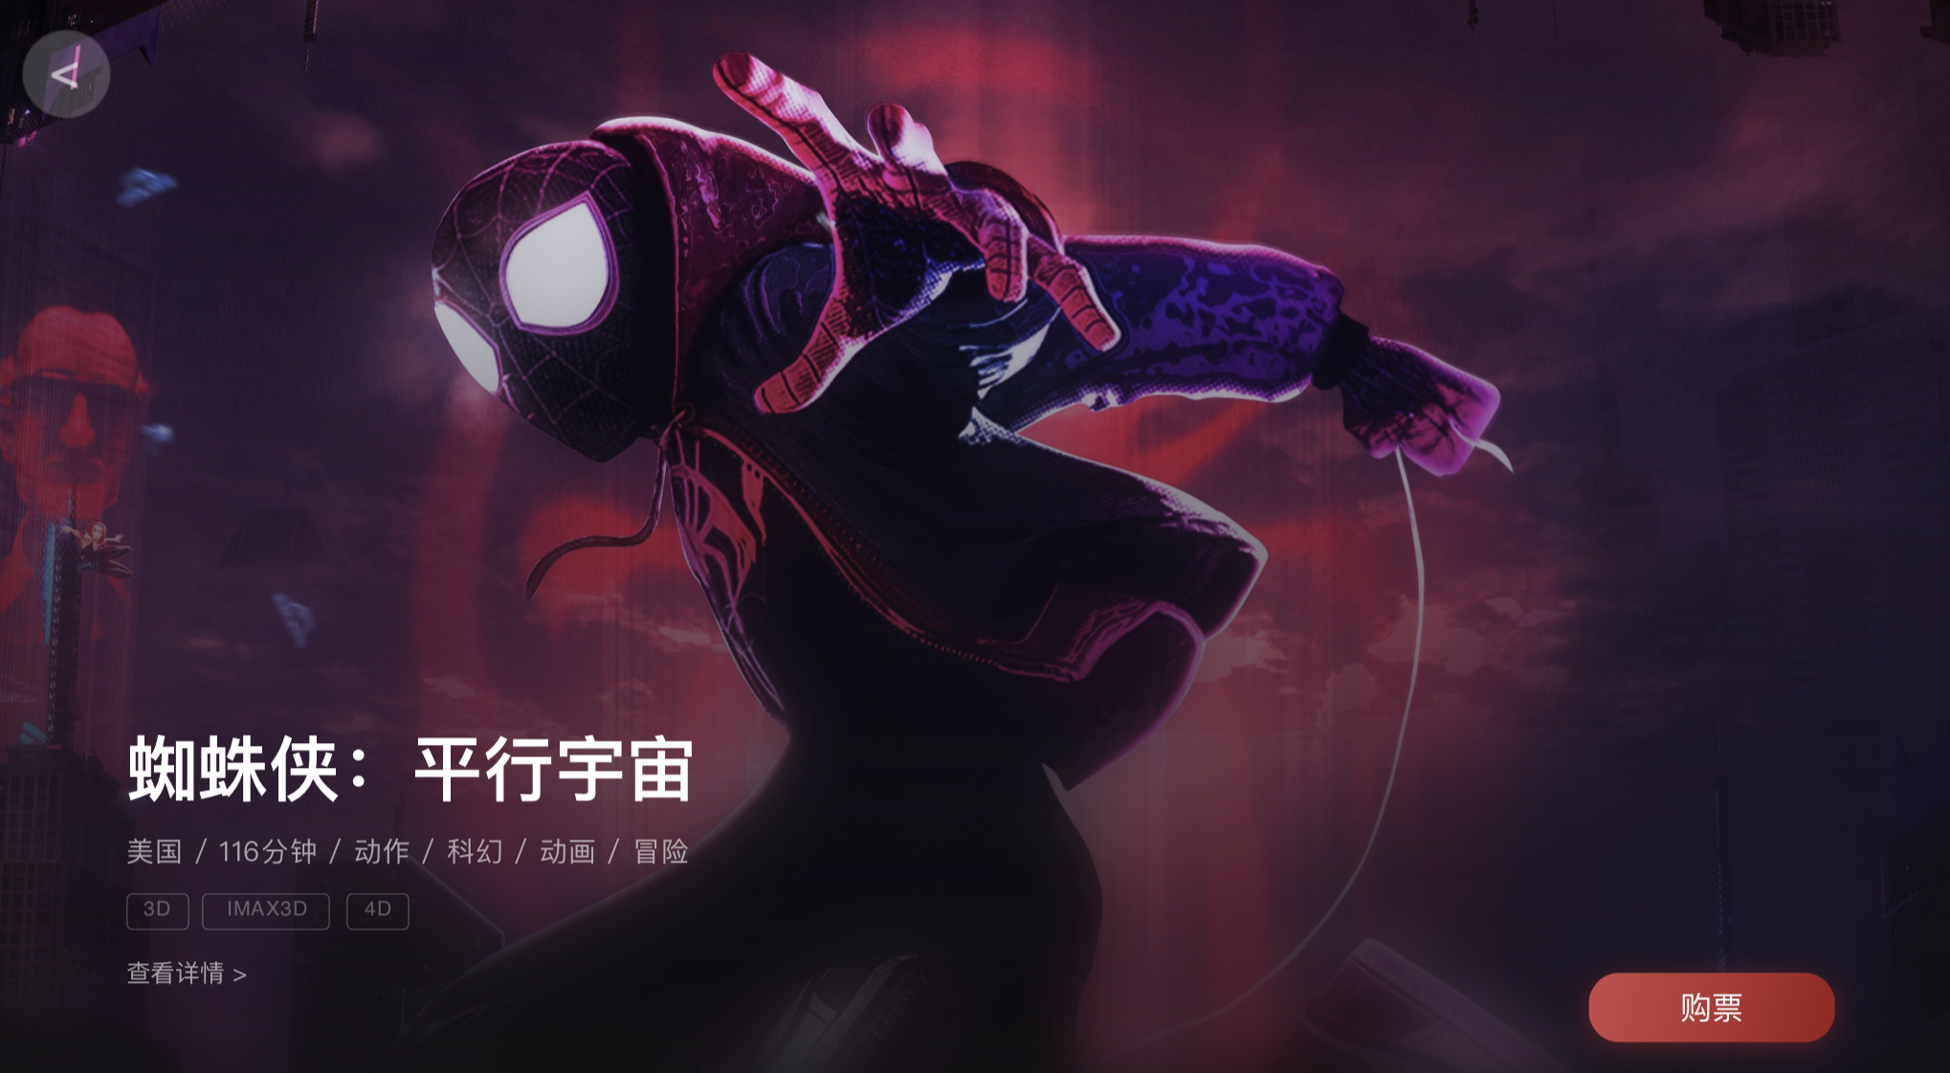
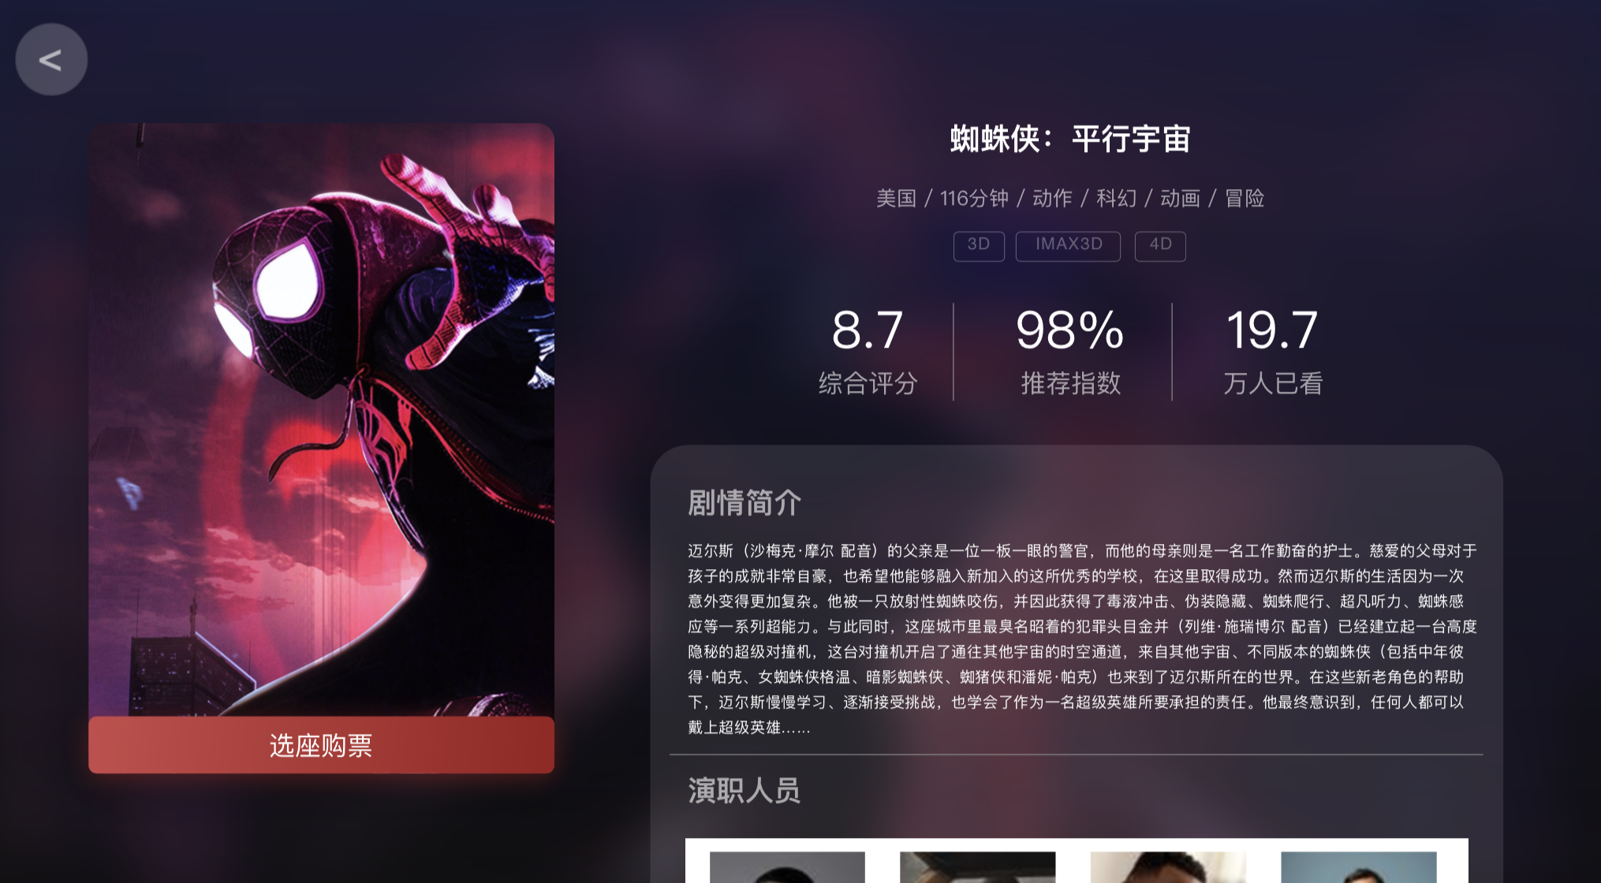
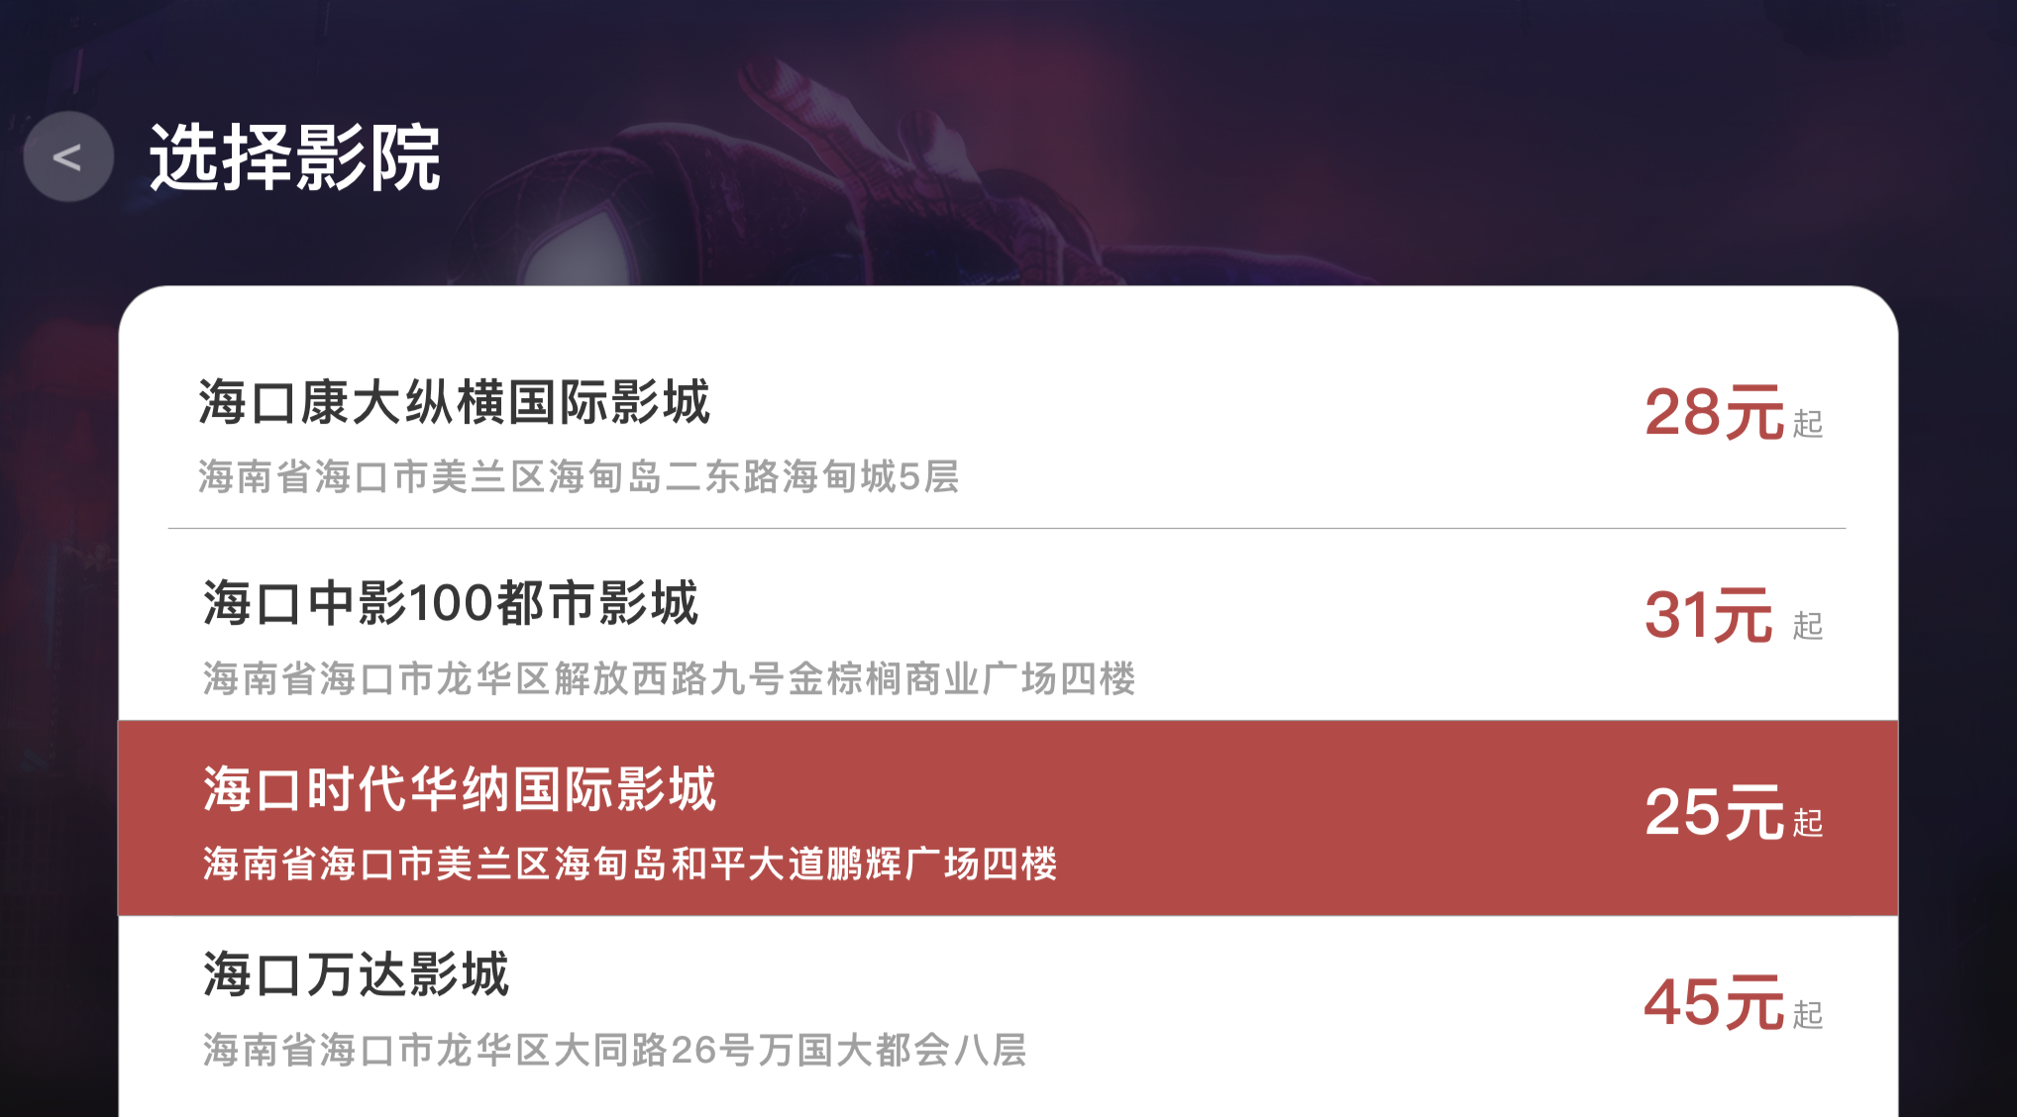
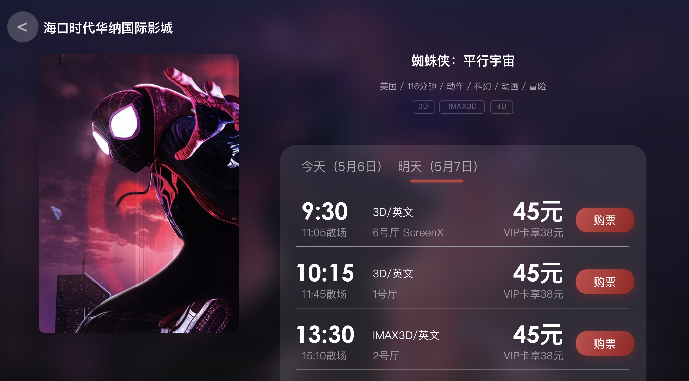
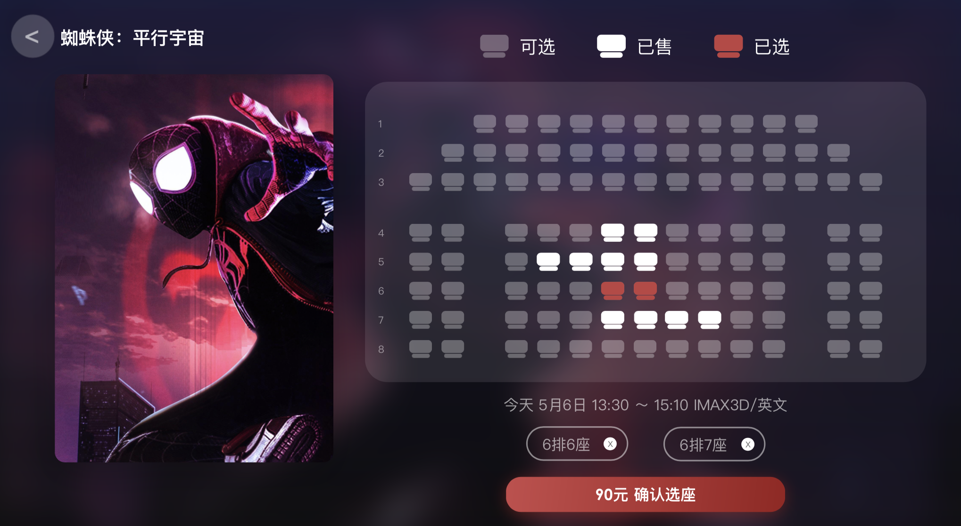
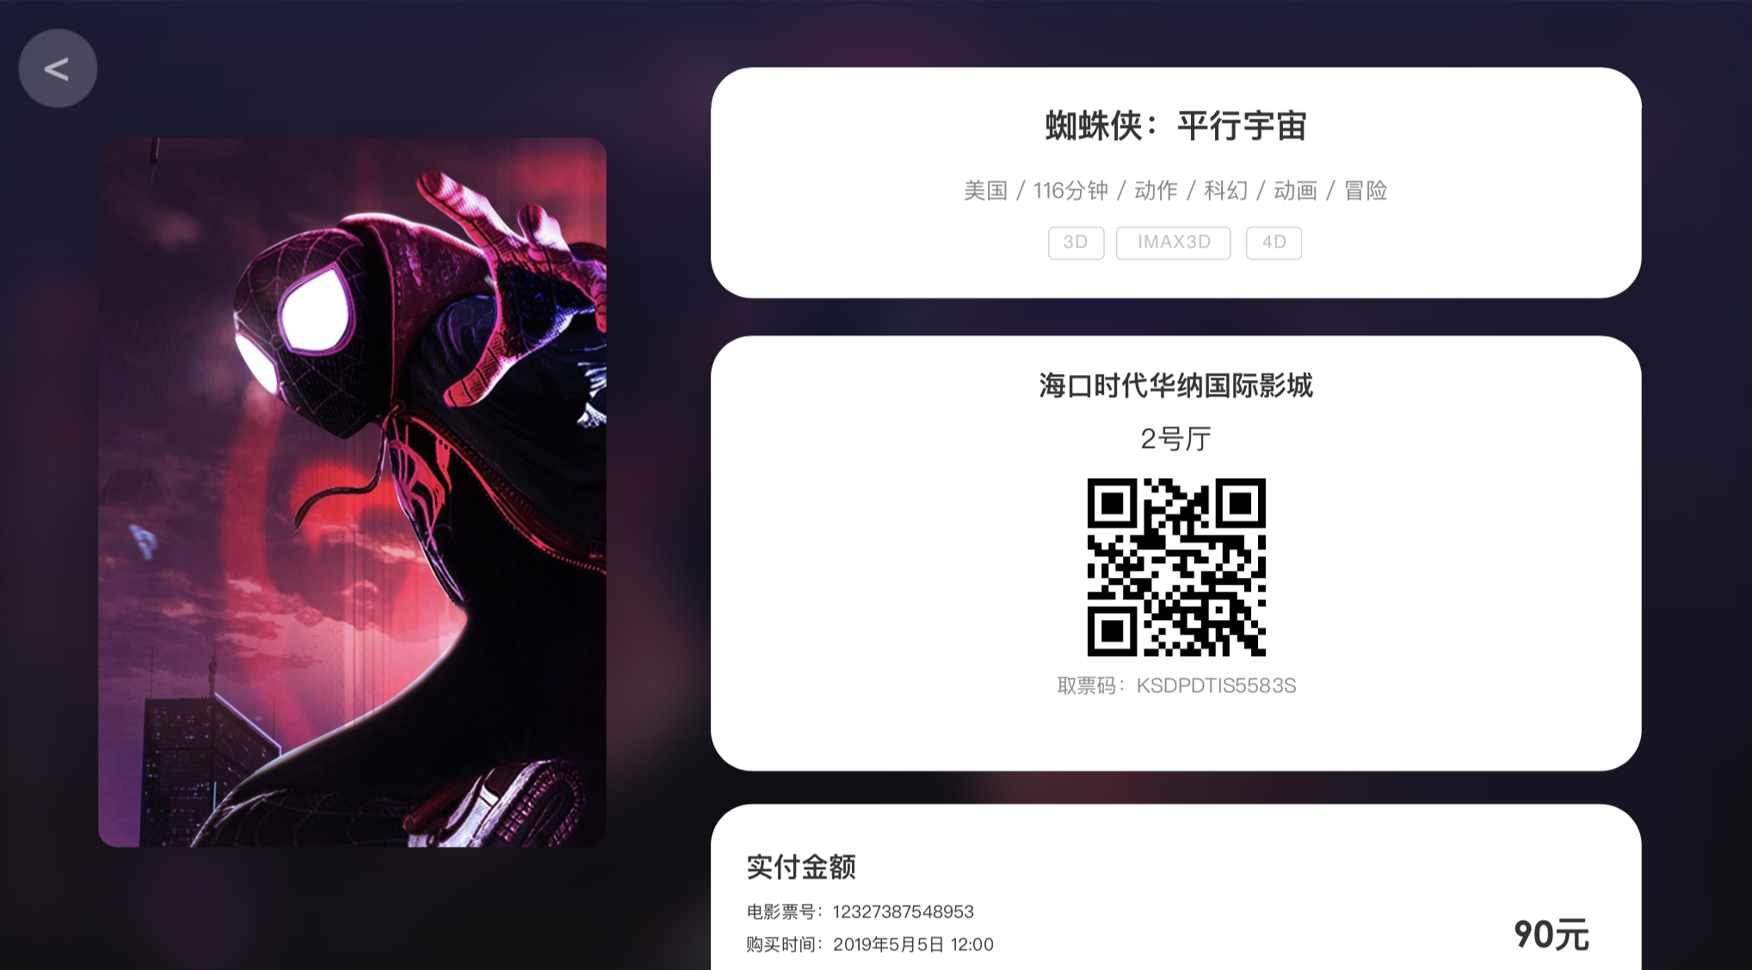

The main page of app.

Slide 26
One more thing …

Slide 27
The QR Code …

Slide 28
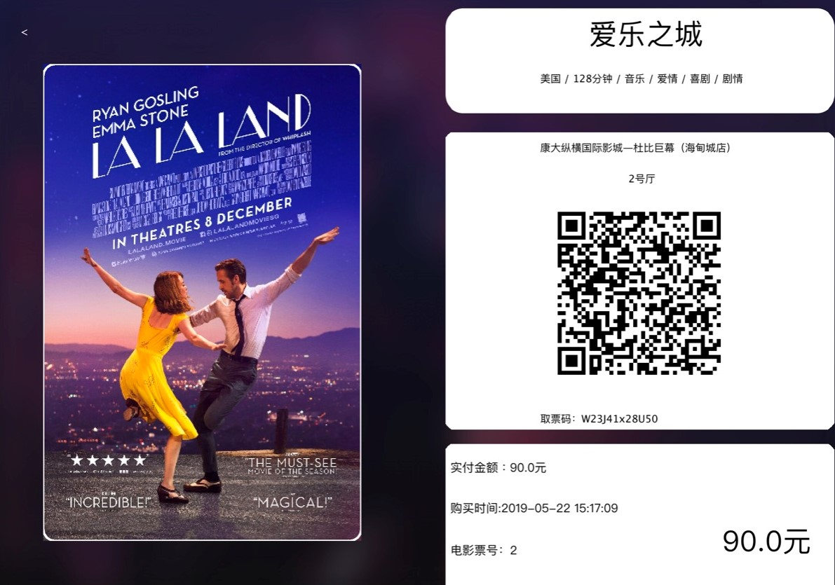
The QR Code

Slide 29

Thank you
for watching！
谢谢观看！

